Slide 1
Take me Away
CS122 Project proposal
Computer Science with Applications 2
Hector Salvador and Carlos Grandet
January 26th, 2016

Slide 2
What is our goal?
Problem?
Solution!
You want memorable trip experiences
Fifth time in Chicago and don’t want to go (again) to Navy Pier?
What if I told you there is an all-you-can-eat ramen place right next to the Eiffel Tower at $8 USD?
What if we told you that buying in the little stall behind the train station in Cusco could save you $50 USD for that same alpaca scarf?
Customizing your trip is a time-consuming task
Are you sure you want to spend 3 hours looking for a decent hostel in Bangkok?
Love Björk’s and you didn’t know she had an exhibition at the MoMA?
Develop a website suggesting customizable and affordable trips
Based on reviews scattered across the internet
Based on your own likes and preferences
Offering daily schedules for your trip
With destinations near your main interests (and suggestions if you want to improvise while already on the go!)
A map with your points of interest to help you track your trip

Slide 3
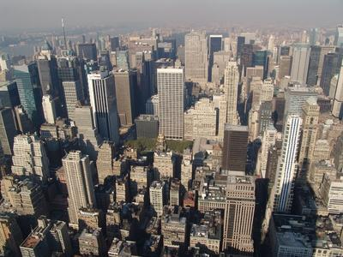
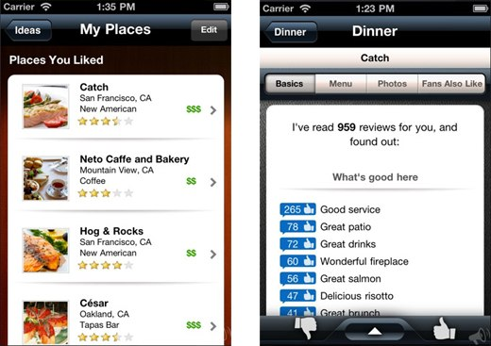
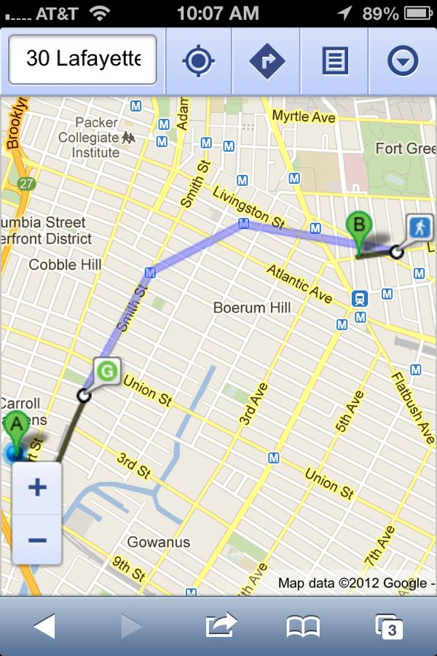
Take me away!
Personalizes options
Suggests places
Maps destinations
Data sources:
Yelp API
Foursquare API
Trip Advisor
Data scrapping:
Yelp
Foursquare
Timeout
Data sources:
Google Maps

Slide 4
How will we do it?
Ask the user for the what, when, where and how of their trip
Connect to a website of travel recommendations (e.g. Yelp)
Get the restaurants/hotels/attractions that are within a given radius
Scrape information of those objects (e.g. location, operation hours, name, reviews)
Process comments and match those that are a best fit through sentiment analysis and string matching
Show the best five matches given time and location restrictions
Give directions for the user to the one selected
Start from point 3 with the new selection

Slide 5
Timeline
Deliverables
Week 3: Database of venues, reviews, and events
Week 5: Mapping function and natural language processing matching
Week 7: Complete webpage
Deliverable due
 | Weeks
 | 1 | 2 | 3 | 4 | 5 | 6 | 7
Connect to APIs
Store and process data through SQL
Select attractions given user restrictions
Scrape reviews
Natural language processing of reviews
Scrape events
Map schedule
Wrap it all together
Create front end

